Slide 1
Software Design (Defn.)
“The process of defining the architecture, component, interfaces and other characteristics of a system or component”
Design Constraints
Budget
Time
Integration with other systems
Skills
Standards
Hardware and software platforms

Slide 2
User Interface Design
Three categories of HCI design guidelines are
* General interaction
* Information display
* Data entry
1. General Interaction
----Be consistent
Use a consistent formats for menu selection, command input, data display .
----Offer meaningful feedback
Provide the user with visual and auditory feedback to ensure that two-way communication (between user and interface) is established.
---Ask for verification of any nontrivial destructive action
If a user requests the deletion of a file, indicates that substantial information is to be overwritten, or asks for the termination of a program, an "Are you sure..." message should appear.

Slide 3
----Permit easy reversal of most actions
    UNDO or REVERSE functions have saved tens of thousands of end users from millions of hours of frustration. Reversal should be available in every interactive application.
  Reduce the amount of information that must be memorized between actions
    The user should not be expected to remember a list of numbers or names so that he or she can re-use them in a subsequent function. Memory load should be minimized.
  Seek efficiency in dialog, motion, and thought
    Keystrokes should be minimized, the distance a mouse must travel between picks should be considered in designing screen layout, the user should rarely encounter a situation where he or she asks, "Now what does this mean."

Slide 4
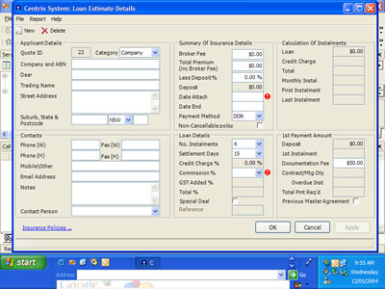

Slide 5


Slide 6
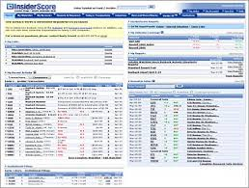

Slide 7
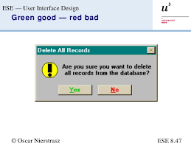

Slide 8
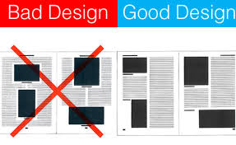

Slide 9
  Forgive mistakes
    The system should protect itself from errors that might cause it to fail (defensive programming)
  Provide help facilities that are context sensitive
2. Information Display
Display only information that is relevant to the current context
    The user should not have to vague through extraneous data, menus and graphics to obtain information relevant to a specific system function.
  Don’t bury the user with data. Use a presentation format that enables rapid assimilation of information
    Graphs or charts should replace voluminous tables.

Slide 10
  Use consistent labels, standard abbreviations, and predictable colors
    The meaning of a display should be obvious without reference to some outside source of information.
  Produce meaningful error messages
  Use windows to compartmentalize different types of information
    Windows enable the user to "keep" many different types of information within easy reach.

Slide 11
  Use “analog” displays to represent information that is more easily assimilated with this form of representation
    For example, a display of holding tank pressure in an oil refinery would have little impact if a numeric representation were used. However, a thermometer-like display was used, vertical motion and color changes could be used to indicate dangerous pressure conditions. This would provide the user with both absolute and relative information
  Consider the available geography of the display screen and use it efficiently
    When multiple windows are to be used, space should be available to show at least some portion of each. In addition, screen size should be selected to accommodate the type of application that is to be implemented.

Slide 12
3. Data Entry
Much of the user's time is spent picking commands, typing data and otherwise providing system input. In many applications, the keyboard remains the primary input medium, but the mouse, digitizer and even voice recognition systems are rapidly becoming effective alternatives. The following guidelines focus on data input:
  Minimize the number of input actions required of the user
    Reduce the amount of typing that is required. This can be accomplished by using the mouse to select from pre-defined sets of input;
  Maintain consistency between information display and data input
    The visual characteristics of the display (e.g., text size, color, placement) should be carried over to the input domain.

Slide 13
  Interaction should be flexible but also tuned to the user’s preferred mode of input
    The user model will assist in determining which mode of input is preferred. A clerical worker might be very happy with keyboard input, while a manager might be more comfortable using a point and pick device such as a mouse.
  Deactivate commands that are inappropriate in the context of current actions.
    This protects the user from attempting some action that could result in an error.
  Let the user control the interactive flow
    The user should be able to jump unnecessary actions, change the order of required actions (when possible in the context of an application), and recover from error conditions without exiting from the program.
  Eliminate “Mickey mouse” input
Do not let the user to specify units for engineering input (unless there may be ambiguity). Do not let the user to type .00 for whole number dollar amounts, provide default values whenever possible, and never let the user to enter information that can be acquired automatically or computed within the program

Slide 14
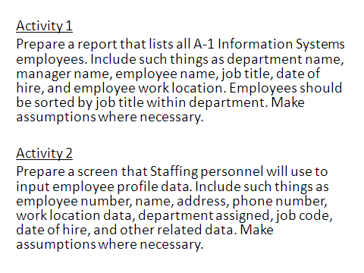

Slide 15
Activity 3
Prepare a Web screen that allows employees to change their personal data such as their address, phone numbers and emergency contacts
ACTIVITY 4
Prepare a web screen to allow managers to search and list all of their employees. Include name, location, Seniority date

Slide 16
What is a Module ?
Modules contain instructions, processing logic and data structures
Modules can be separately compiled and stored in a library
Modules can be included in a program
Module segments can be used by invoking a name and some parameters
Modules can use other modules
Examples of modules include procedures, subroutines and functions
Measuring the goodness of the Design
To Measure design quality, we use coupling (the degree of interdependence between two modules), and cohesion (the measure of the strength of functional relatedness of elements within a module).

Slide 17
COUPLING
Coupling is the measure of strength of association established by a connection from one module to another. Minimizing connections between modules also minimizes the paths along which changes and errors can propagate into other parts of the system
The use of global variables can result in an enormous number of connections between the modules of a program. The degree of coupling between two modules is a function of several factors (1) How complicated the connection is, (2) Whether the connection refers to the module itself or something inside it, and (3) What is being sent or received.
It is shown in Figure .

Slide 18
A
D
I
DATA STR DATA(Var) Control Flag
B
C
E
J
K
F
G
H
Global data area

Slide 19
Types of Coupling: Data passed between module A and C called data coupling. A variation of data coupling, called stamp coupling is found when a portion of data structure (rather than simple arguments) is passed via a module interface. This occurs between modules B and A. Control coupling is very common in most software designs and is shown in fig., where a ‘control flag’ is passed between modules D and E. (parameter passing occurs)
High coupling also occurs when a number of modules reference a global data area. This is common coupling modules C, G, and K each access a data item in a global data area. The highest degree of coupling, content coupling, occurs when one module modifies an internal data or control information maintained within the boundary of another module. Secondarily, content coupling occurs when branches are made into the middle of a module.

Slide 20
COHESION
Designers should aim for loosely coupled and highly cohesive modules. Coupling is reduced when the relationships among elements not in the same module are minimized. Cohesion on the other hand aims to maximize the relationships among elements in the same module. Cohesion is a good measure of the maintainability of a module. Stevens, Myers, Constantine, and Yourdon developed a scale of cohesion (from highest to lowest):
Functional Cohesion (Best)
Sequential Cohesion
Communicational Cohesion
Procedural Cohesion
Temporal Cohesion
Logical Cohesion
Coincidental Cohesion (Worst)

Slide 21
Let us create a module that calculates average of marks obtained by students in a class:
calc_stat(){
// only a pseudo code
read (x[])
a = average (x)
print a
}
average(m){
sum=0
for i = 1 to N{
sum = sum + x[i]}
return (sum/N)
}
In average () above, all of the elements are related to the performance of a single function. Such a functional binding (cohesion) is the strongest type of binding.

Slide 22
Suppose we need to calculate standard deviation also in the above problem, our pseudo code would look like:
calc_stat(){
// only a pseudo code
read (x[])
a = average (x)
s = sd (x, a)
print a, s
}
average(m){ // same as before
…
}
sd (m, y){//function to calculate standard deviation
…
}

Slide 23
Now, though average() and sd() are functionally cohesive, calc_stat() has a sequential binding (cohesion). Like a factory assembly line, functions are arranged in sequence and output from average() goes as an input to sd(). Suppose we make sd() to calculate average also, then calc_stat() has two functions related by a reference to the same set of input. This results in communication cohesion.
Let us make calc-stat() into a procedure as below:
calc_stat(){
sum = sumsq = count = 0
for i = 1 to N
read (x[i])
sum = sum + x[i]
sumsq = sumsq + x[i]*x[i]
…}
a = sum/N
s = … // formula to calculate SD
print a, s
}

Slide 24
Now, instead of binding functional units with data, calc-stat() is involved in binding activities through control flow. calc-stat() has made two statistical functions into a procedure. Obviously, this arrangement affects reuse of this module in a different context (for instance, when we need to calculate only average not std. dev.). Such cohesion is called procedural.
A good design for calc_stat () could be as shown in the Figure

Slide 25
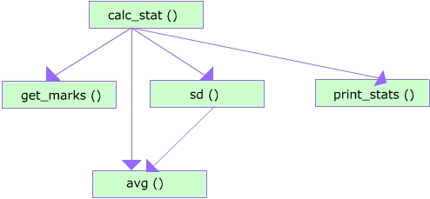

Slide 26
In a temporally bound (cohesion) module, the elements are related in time. The best examples of modules in this type are the traditional “initialization”, “termination”, “housekeeping”, and “clean-up” modules.
A logically cohesive module contains a number of activities of the same kind. To use the module, we may have to send a flag to indicate what we want (forcing various activities sharing the interface). Examples are a module that performs all input and output operations for a program. The activities in a logically cohesive module usually fall into same category (validate all input or edit all data) leading to sharing of common lines of code. Suppose we have a module with all possible statistical measures (like average, standard deviation, mode, etc.). If we want to calculate only average, the call to it would look like calc_all_stat (x[], flag1, flag2, para1,…). The flags are used to indicate out intent. Some parameters will also be left blank.
When there is no meaningful relationship among the elements in a module, we have coincidental cohesion

Slide 27
Use of coding standards achieves the following :
Direct correspondence between design components to code components conforming design translation into a code.
Ease of understanding helping modification and maintenance
Use of automated tools is feasible and efficient
Increases reusability of code
Fault-management improves due to quick diagnosis of the problem/fault and identification of the locations in the code

Slide 28
Programming style standards
General program styles:
Variable names should be mnemonic, clear and simple e.g. “largest” rather than “x”.
Expressions should be clear and simple e.g.: abs (x) <=0.01” rather than “(x<0.01) and x> -0.01)”
Indentation and format
Indent bodies of structured statements at least 3 spaces
Leave blank lines between logically related groups of statements, after the declarations and between functions
rap long lines at no more than 80 chars and indent the continued statement further than the beginning of that statement.
I/O Behavior
All I/O should use a proper format.
All real number output should be formatted in decimal form unless scientific notation is appropriate.
All input from the keyboard should be preceded by a prompt telling the user what format is expected. For example “, Please input the date in mm/dd/yy format”.
Label all output values

Slide 29
Commenting
Program should begin with a preface stating:
Programmers name
Date written
Course and assignment number
A summary or description of functionality i.e. what the program does and a brief description of how to run it.
Any known assumptions built into the program
Any special instructions on how to run it.
Program Robustness
Do not check for equality among real numbers
Prevent the abnormal termination of a program due to input error, check for the validity of the data when appropriate.
Programs should not be built around a specific data set, programs, unless otherwise stated, should work correctly for any reasonable test data set.
Do not use GOTO statements.

Slide 30
Modules and Modular Program Structure
  Module independence: each module should be independent. i.e. it should be self-contained and it should perform its task successfully without needing to know the inner working of the calling module.
  Procedures or functions should , in general occupy at most 50 lines
  Use appropriate parameters rather than global variables. Avoid side effects.
  Hide any information from the caller that it does not need. The default should be to hide information unless the caller actually needs it.
Program Testing
The program should follow the program specifications delineated in the problem statement.
Testing should be sufficient to thoroughly check all parts of the program
Make sure that the output of your program illustrates that it does in fact solve the problem.

Slide 31
Programming Guidelines
All programs have three main factors that need to be handled properly to make a program efficient and effective for which it is written. Three factors are Control Structure, Algorithms and Data structures
Control Structure
Control structure is used in the program to move the flow of processing from one stage to another or from one branch to another. In object-oriented systems, control is based on system states and changes in variables. In conventional procedural design, control is dependent on the control structure itself. In either case, program structure should be in sync with design structure. Ideally, the program flow should be top-down.

Slide 32
Algorithms
Programs use algorithms to achieve certain functions such as sort, search, select, etc., It is used while writing the code. The same result can be achieved by writing a code. So, the issue is, should one use an algorithm or write a code.
Data Structures
It is advised that program be organized in line with data structure. Program design requires use of data structure in implementing the function. Data structure influences the program organization and flow of the program. It influences the choice of the language, as well.

